Slide 1

Adaptive Multi-Market
Reinforcement Learning
Trading System
A Risk-Aware Algorithmic Advisor designed to dynamically optimize financial trading strategies across volatile market regimes.
CM3070 Final Project Submission
University of London BSc Computer Science Final Project (CM3070)

Slide 2






CORE SYSTEM PILLARS
Adaptive State Tracking
Risk-Aware Penalties
Optimized Execution
Directly constraints aggressive allocation decisions through custom reward adjustments, preventing sudden tail risk event exposure.
Leverages policy parameter spaces to efficiently discover profitable routes through highly dimensional trade execution regimes.
Captures dynamic macroeconomic variations and micro-structural regime shifts without losing historical performance baselines.
CM3070 Final Project | Adaptive RL Advisor
Slide 02

Slide 3


TECHNICAL ARCHITECTURE
Unified Data & Policy Engine
Unified Data Pipeline: Real-time financial metrics and stream ingestion for high-fidelity state representation.
PPO with Transformer Extractor: Training engine using Proximal Policy Optimization with a custom DeepTransformerExtractor to capture long-range temporal dependencies.
Explainable AI (XAI): Integrated engine for feature and policy attribution maps, providing quantitative transparency.
Frontend Interface: React (Vite) web interface served by a FastAPI backend.
System Framework | React + FastAPI Implementation
Slide 03

Slide 4
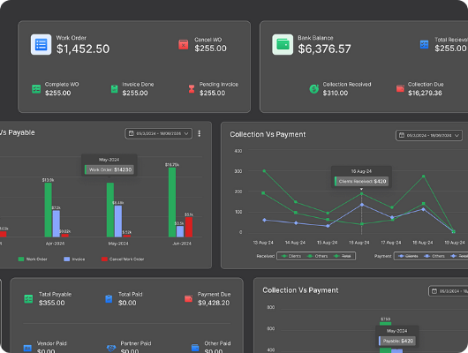

SYSTEM PERFORMANCE EVALUATION
Methodology: 5-Fold Walk-Forward Validation (WFV)
Performance Metric | RL Advisor | Buy & Hold
Overall Net Return | +11.11% | +24.67%
Annualized Sharpe | 2.41 | 1.12
Max Drawdown (DD) | 5.30% | ~15.00%
0.9991
-4.91%
MEAN XAI FIDELITY (RHO)
MEAN DRAWDOWN (DD)
Rigorous Out-of-Sample Validation
Slide 04

Slide 5
FUTURE HORIZONS & EXPANSION
Phase 01
Phase 02
Phase 03
Phase 04
HMM Optimizations: Classifying market regimes to filter noise.
Cross-Asset Training: Expanding weights to correlated groups.
Retail User Beta: Feedback from non-technical target audience.
UI Refinement: Interface polish and feature expansion.
Strategic Development Plan
Slide 05

